Slide 1

Integrating CCAvenue

Slide 2








CCAvenue offers Web Integration for the following platforms
Mobile Integration support for :

Slide 3
Integrating CCAvenue
CCAvenue payment gateway integration : allows merchants to instantly collect payments from their users using various payment modes like
Credit cards
Debit cards
Cash cards,
Netbanking etc.
The CCAvenue payment integration supports a seamless payment experience on your platform, while protecting your application from payment frauds and complexity related to various regulations.

Slide 4
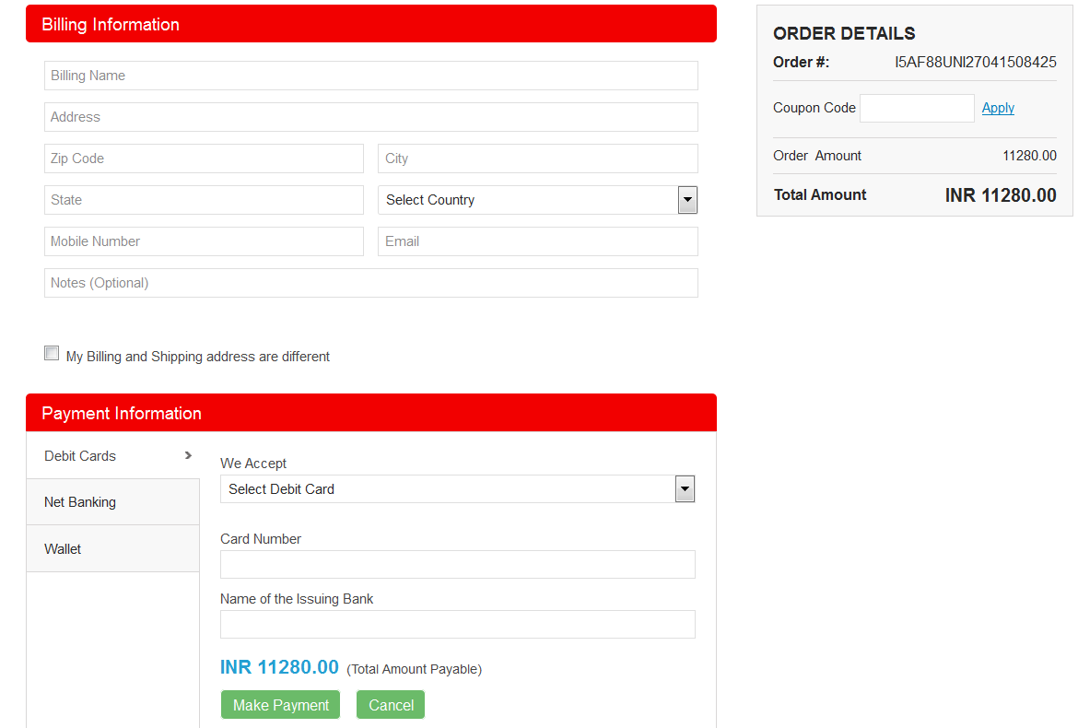
Types of integration Offered:
1.1 CCAvenue billing page (Non-Seamless) –
Avoid the hassle of developing and managing your own checkout page. Use the customizable billing page provided by CCAvenue which enables you to collect billing and shipping information of the customer.

Slide 5
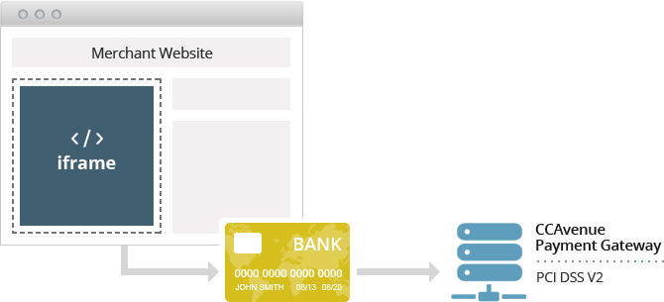
Types of integration Offered:
1.2. CCAvenue iFrame checkout –
Fastest and easiest way to enable payments on your website. CCAvenue iframe checkout is a pre-configured form, which validates the payment data, allows users to store card information to expedite the payment process in future. CCAvenue iFrame checkout also handles PCI compliance.
Collect card credentials and accept payments on your checkout page using our secure iFrame integration without being PCI DSS certified. Reduce payment hops and allow customers to make secure payments without leaving your webpage for a seamless brand experience.

Slide 6
Types of integration Offered:
1.3 a. Custom checkout form –
Merchants can build a custom checkout form to collect order and payment information and pass on the same to CCAvenue server for payment processing. CCAvenue can also store the payment information of the customer to expedite the payment process in future.
1.3 b. Direct Connect -
This integration enables you to deliver payment services directly through your website without redirecting your users to CCAvenue. You can not only build your own custom checkout form, but also control the payment request process with the banks. On submission of the payment information, merchant initiates a server-to-server call to CCAvenue to fetch the request payload for the payment option selected by the user. The request payload received from CCAvenue will be used by you to connect directly to the bank’s authentication/3D secure page, bypassing CCAvenue. However the response handling would be at CCAvenue. CCAvenue will receive the authentication status from the bank and in turn post the
transaction status back to the merchant’s website.

Slide 7
Types of integration Offered:
1.4. CCAvenue shopping cart -
CCAvenue provides merchants with a product management module and a customizable shopping cart, thereby eliminating the need for developing/maintaining their own.
Integrate the CCAvenue Shopping Cart with your website and start selling online in less than 24 hours with the most basic HTML knowledge. Simply add your products details, insert "Add to cart" button for all products and link it to the CCAvenue gateway. Customize the shopping cart page to match the look of your website and you're ready to sell online.
CCAvenue Shopping Cart is designed using Responsive Web Design approach and is built to adapt to all devices. This enables your customers to shop even on the go.

Slide 8
Integrating CCAvenue
For the web integration all that needs to be done is:
The URL from where the merchant would initiate the transaction has to be registered with us. Kindly send that to service@ccavenue.com.
b) Referring the sample codes provided in the Admin panel, the mandatory parameters like merchant id, order id, amount, security keys, return url etc. has to be posted to us.
c) The payment page would be rendered (or card details can be collected on your portal based on the type of integration) and on completion of the transaction the parameters are posted back to the return URL.
d) The Login details to the Admin account would be emailed to your registered id to pick the Merchant id, access code and encryption key

Slide 9
Integrating CCAvenue
Steps To download the integration kit :
Step 1 : Login to CCAvenue M.A.R.S Panel (Dashboard).
Step 2: Click on Resources on the navigation bar of the Dashboard --> Integration Kit,
Steps To retrieve the API keys :
Step 1 : Login to CCAvenue M.A.R.S Panel (Dashboard).
Step 2: Click on Settings -- > API keys tab: Here you would get the merchant ID , access code , encryption key in the dashboard provided to your from CCAvenue.

Slide 10
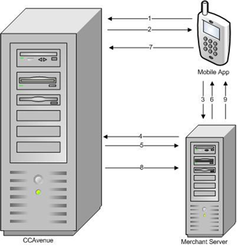
Mobile Integration on CCAvenue
Flow of transaction for Mobile App transactions

Slide 11
Mobile Integration on CCAvenue
Steps to mobile integration:
Request for payment options from Mobile App to CCAvenue
JSON data with payment options returned
Request for encryption key from Mobile App to Merchant server
Request for encryption key from Merchant server to CCAvenue
Dynamic encryption key returned
Encryption key sent from Merchant server to Mobile App
Transaction with encrypted data sent from Mobile App to CCAvenue
Processed transaction status returned to Merchant server
Transaction status pulled by Mobile App

Slide 12
Automate the PG experience !!
Use our extensive range of robust APIs that lets you focus
on powering your business
APIs to manage transactions:
Confirming transactions
Cancelling transactions
Refunding transactions
Status Querying
Order Lookup..Etc..
APIs for Updating parameters post completion of transactions
Update Merchant Parameters
Update Billing Details
APIs for sending and managing E-Invoices viz.
Generate Invoice
Generate Recurring Invoice
Generate Quick Invoice
Get Item List
Invoice Lookup
Update Merchant Invoice Reference
APIs for managing vault.
Get Customer Payment Option
Delete Customer Payment Option
Delete Customer

Slide 13
API Calls
Explanation of the various APIs exposed by CCAvenue:
1. Confirm – The Confirm API call allows you to confirm a pending order. Only confirmed orders are settled into the merchant’s account. An order older than 12 days is automatically cancelled. Once an order has been auto-cancelled by the system, it cannot be confirmed.
2. Cancel – The Cancel API call allows you to cancel a pending order. Funds will be refunded to the credit card or debit card or net banking account that was originally charged. An order older than 12 days is automatically cancelled.
3. Refund – The Refund API call allows you to refund an order/transaction that has previously been executed but not yet refunded. Funds will be refunded to the credit card or debit card or net banking account that was originally charged.
4. Status – The Status API call can be used to ascertain the status of a transaction/order. You can use this call if you have not received status/information for a transaction request. It can also be used as an additional security measure to reconfirm the parameters posted back.
5. Order Lookup – The Order Lookup API call can be used to find transactions/orders based on given criteria.

Slide 14
API Calls
6. Pending Orders – The Pending Orders API call can be used to list transactions which are yet to be confirmed or cancelled. Pending orders need to be confirmed for them to be settled, those older than 12 days are automatically cancelled.
7. Get Customer Payment Option - The Customer payment option API call is used to list payment options saved for a customer. Payments options are saved for a customer in the vault for easy and convenient payment.
8. Delete Customer Payment Option - The Delete Customer Payment Option API call is used to delete a particular payment option saved for the customer.
9. Add Customer Payment Option - Add Customer payment option API call is used to add another payment option for registered customer of the merchant.
10. Delete Customer - The Delete Customer API call is used to delete all saved payment options for the customer.
11. Generate Invoice - The Invoice API call is used to generate an invoice for a customer. Values can be passed as for generating invoice using the flexibility of Invoice Settings.
12. Generate Recurring Invoice - Recurring invoice call is used to generate recurring invoice for a customer of a merchant .

Slide 15
API Calls
13. Generate Quick Invoice - This Quick Invoice API call is used to generate a quick invoice for a customer. This is a flavour of regular invoice but with limited options; hence an easy implementation.
14. Get Item List - The Item list API call is used to find the list of configured Items and task for merchant. The items and tasks are used to create a regular Invoice or a recurring invoice.
15. Invoice Lookup - Invoice Lookup API call is used to find list of invoice order lookup details of orders.
16. Update Merchant Invoice Reference No - Update Invoice reference Number API call is used to update Invoice reference number if the same was not provided at the time of invoice generation.
17. Update Merchant Param - Update Merchant params API is used to add some extra parameter against Merchant params if the same could not be done at the time of the transaction.
18. Update Billing Details - Update billing details API call is used to update customer billing information against an order.

Slide 16
Automation using dynamic event notification
Dynamic Events Notification helps posts data of events occurring in your merchant account to your application. Register destination URLs that will receive notifications for order status, order refund status and order risk status that occur.
This feature will help you to fetch the transaction details through an asynchronous method. For every attempt CCAvenue will pass you the "encresp" parameter to your configured URL. Kindly use the logic which you have applied for transaction value decryption. you will be able retrieve the response values which has been posted to you for the transaction.

Slide 17
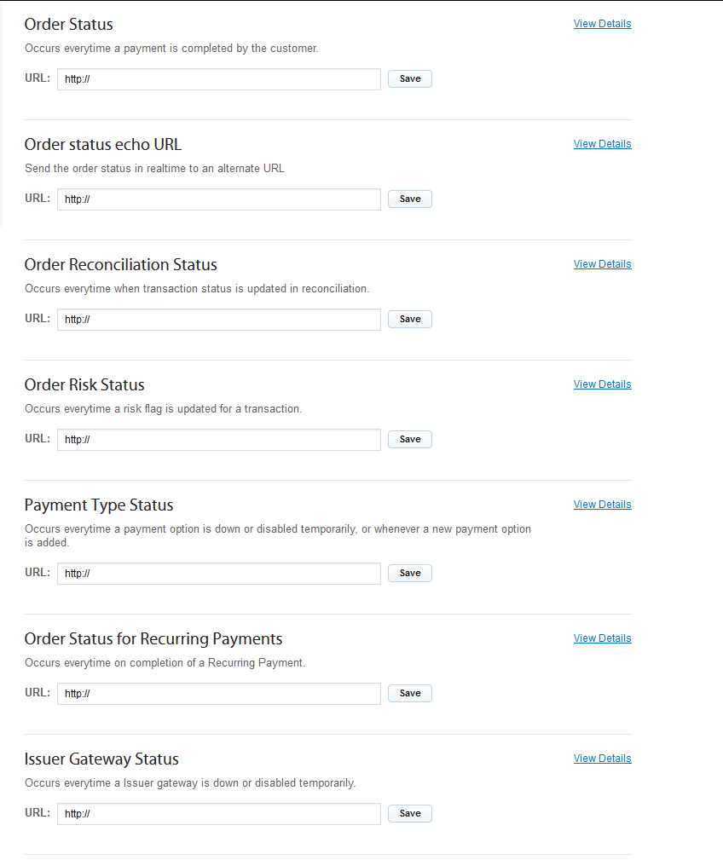
Automation using dynamic event notification

Slide 18
Automation using dynamic event notification
Configure URLs for events
Order Status: If the merchant does not post a returnURL, and stores a URL in this section, the customer would be redirected to the page specified here. For eg in invoice payments the CCAvenue page loads with status of transaction, merchant may choose to display his page.
Order status echo URL: an asynchronous push of the response parameters is done in real time to this alternate URL.
Order Reconciliation Status: Why wait for offline recon sheets from bank when this can be automated. CCAvenue periodically does an authStatusQuery to the banks (who provide this facility) and if the status is updated we push the response to the merchant . For the rest of the banks status is posted once the offline recon is done.
Order Refund Status: If a full or partial refund has been issued and when our system accepts the refund the status is posted back to the merchant. You may want to update the same into your database.
Payment Type Status : Each time a payment option is down or disabled temporarily or finally up, the status is pushed to your server.
P.S: In case your server has not received this notification due to any issues the payment option may be down for longer than it actually. Hence we recommend you use the JSON call regularly to re-check. CCAvenue also sends email notification for the same. Please share your email ids in case you wish to receive gateway monitoring notifications.

Slide 19
Checklist for integrating CCAvenue.
JSON call:
For merchants implementing CCAvenue custom checkout mode of integration this feature will allow the merchant to fetch the payment option along the bank health check up status of bank. Eg Active, Down, Fluctuating etc.
Status API call :
The Status API call can be used to ascertain the status of a transaction/order. You can use this call if you have not received status/information for a transaction request. It can also be used as an additional security measure to reconfirm the parameters posted back.
Refund API call:
In this feature you may automate the refunds and raise refund request from your application.

Slide 20
Checklist for integrating CCAvenue.
Retry:
This feature allows the end user to retry any failed transaction for upto 3 times. (Please note: Control to enable this feature is at our end). Allowing customers to retry increases chances of conversion of any failed transaction to a successful transaction.
Autoconfirm :
The success transactions would converted into shipped status automatically by the system, thus ruling out manual intervention to confirm transactions. (Please note: Control to enable this feature is at our end and is enabled based on approval).
Instant Gratification:
Incase status of the transaction has not been communicated by the bank and the amount is debited by the bank from the customer this feature will treat the transaction as failure and reversal request would be sent to the bank on our reconcilliation with the bank.. (Please note: Control to enable this feature is at our end, kindly confirm so that we can enable)

Slide 21
Checklist for integrating CCAvenue.
Reconciliation Report:
By configuring this feature, the list of transactions processed through CCAvenue would be sent to you on a daily basis along with the order status as a dump. (Please note: Control to enable this feature is at our end, kindly confirm the list of email addresses to which the email has to be sent, so that we can configure.)
Settlement Report:
In this report the transaction details would be sent to you for which payment released from CCAvenue. (Please note: Control to enable this feature is at our end, kindly confirm the list of email addresses to which the email has to be sent, so that we can configure.).

Slide 22
MIS provision
The transaction reconciliation/settlement report would be sent to you via various methods viz.,
FTP
API
Email and
Dashboard
The recon report contains the list of transactions processed through your account in a day and cut off for the report generation time would be midnight 12.00 AM (IST).
Settlement report would have the break up of all transaction including card type paid out for that cycle.

Slide 23
MIS provision
Kindly find the details on the mentioned mechanism for your reference:
FTP:
To configure this we require the details such as URL, Port #, Username, Password and Directory Path. The files would be pushed here daily.
API: CCAvenue provides APIs which allows merchant to make a server to server call to get details of any payout basis the pay id.
Email:
This allows users to receive an email with the attachment (.XLS/.XCV) on a daily basis. To configure this, please share list of email addresses.|
Dashboard:
CCAvenue provides an extensive dashboard to download the reports at your convenience. The url for the dashboard is:
https://login.ccavenue.com/jsp/merchant/merchantLogin.jsp

Slide 24
Support
Technical Support Contact Details:
For training on MARS or support required during the integration process you may contact our support desk, which is available round the clock
Telephone Support : 022-67425555
Customer Queries : 401,402,403,404
Merchant Queries : 405,406,407,408,409

